Slide 1
YANG CONFORMANCE
Compliance with behaviour, standards, and rules
7 July 2016

Slide 2
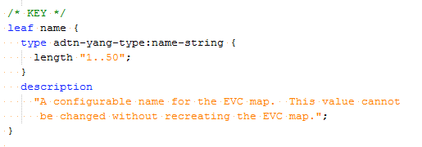
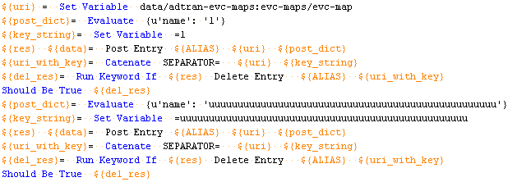
Overview
GET
POST
PATCH
DELETE
PUT not supported
200
OK
201
Content created
204
Content deleted
501
Command not implemented on server
Device Models
Management Application Models

Slide 3









Capabilities
Firefly models
ADTRAN extensions
TBaaS Instance
Uses a TBaaS Resource
Hello message
Manual or UUT response
Deviation module
Product Specific Implementations
Perforce
Sync models from perforce
PIP installable
pip install yang_conformance
Jenkins CI
Win/Linux
Beacon Docs
GitHub

Slide 4


YANG Conf. Usage
pip install --upgrade --trusted-host pypi.adtran.com -i http://pypi.adtran.com/simple yang_conformance
Request
Response
Parse JSON
Hello message
Capability JSON
Input to Pyang
Produces YANG Tree
Generates python code
Executes
yang_conformance generate -u http://A.B.C.D/restconf/SNMPslot254 -f robot
yang_conformance execute -t "{'testbed' : 'ta5k_testbed', 'am_image' : 'gpon', 'slot' : 1, 'tam_build' : 'TAML.D2307'}" -f robot
Hello message
Sync models form P4
Invoke pyang plugin
yang_conformance
Execute

Slide 5
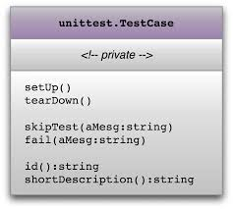

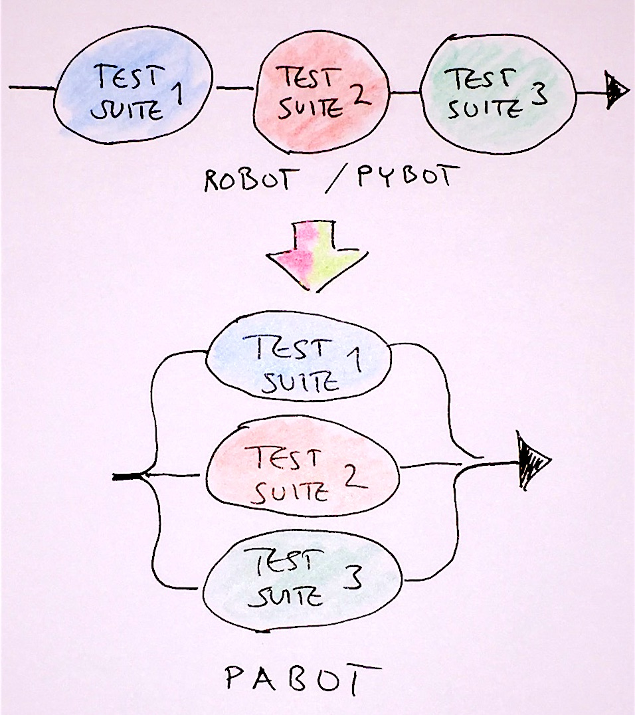
Test Support
Ranges
Lengths
Choice
Enumeration
Unions
Lists
Basic Test
POST-PASS
PATCH-PASS
STATIC-PASS
Load Test
POST-LOAD-FAIL
PATCH-LOAD-FAIL
Stress Test
Pagination
Depth
Notifications
POST-PASS
PATCH-PASS
STATIC-PASS
Above all
All Tests are performed according to RFC 6020 and Restconf draft version.

Slide 6


Development costs
Increase human Effort
Identification problem will become harder
Decrease Performance
Limits the number of Regressions
YANG Element | Automation | Human
Field | ~ 1 ms | ~ 11 sec
List (5 Fields) | ~ 5 ms | ~1 min
Container (5 Lists) | ~ 25 ms | ~ 5m
YANG models
Accessing Server
Validate model with server
Apr. Test values
Increases number of regressions
Fixing problem will be easier
Reduces human efforts
Identification problem will be easier
YANG models
Accessing Server
Validate model with server
CI integration
Operation | Tests | Pass | Fail | Elapsed
PATCH-LOAD-FAIL | 78 | 61 | 17 | 52 sec
PATCH-PASS | 53 | 33 | 20 | 30 sec
PATCH-VAL-FAIL | 42 | 31 | 11 | 26 sec
POST-LOAD-FAIL | 5 | 5 | 0 | 01 sec
POST-PASS | 2 | 2 | 0 | 02 sec
POST-VAL-FAIL | 12 | 11 | 1 | 01:28:54 sec
STATIC | 2 | 0 | 2 | 01 sec
Test run against OLT

Slide 7
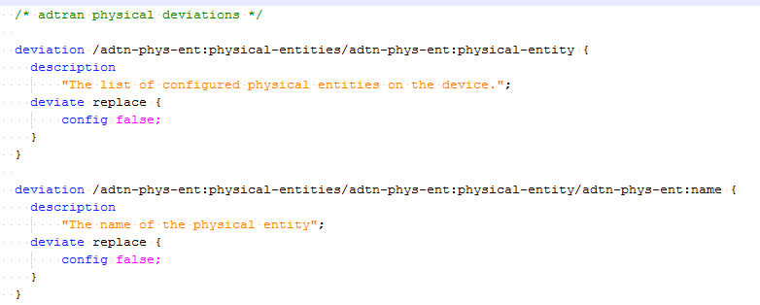
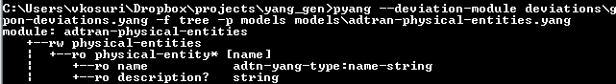
Challenges
UUT Revisions <= Yang Revision
Multiple Outputs
NETCONF/RESTconf
Robot/unittest
Deviations

Slide 8

Few More and Demo
User Guide: http://yang.adtran.com/docs/yang_conformance/latest/
Github: https://github.com/ADTRAN/sdvt-yang-testing
Jenkins Example: http://jenkins.adtran.com:8080/job/sbt/job/rest_gpon_taml/

Slide 9


